Slide 1


Instructions
How to add fulfilled meeting roles to your Pathways profile

Slide 2
Why add meeting roles to your profile?
As part of Pathways, you need to fulfill the following meeting roles at least once in order to complete each Level
  Ah-Counter
  General Evaluator
  Grammarian
  Speech Evaluator (also need to complete within Level 1)
  Timer (you can put the same date for Ah-Counter and Grammarian)
  Toastmaster
  Table Topicsmaster

Slide 3

Navigate to Basecamp

Slide 4
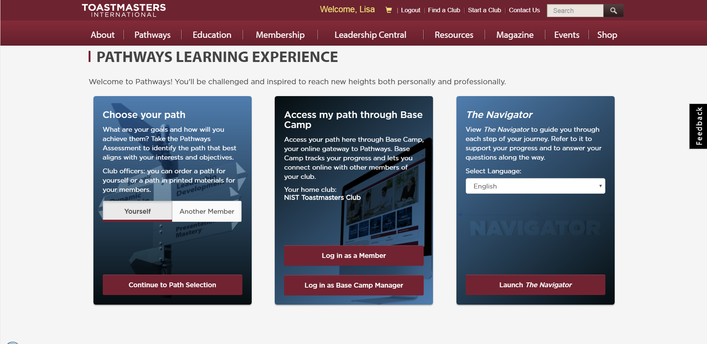
Log in as a Member

Slide 5
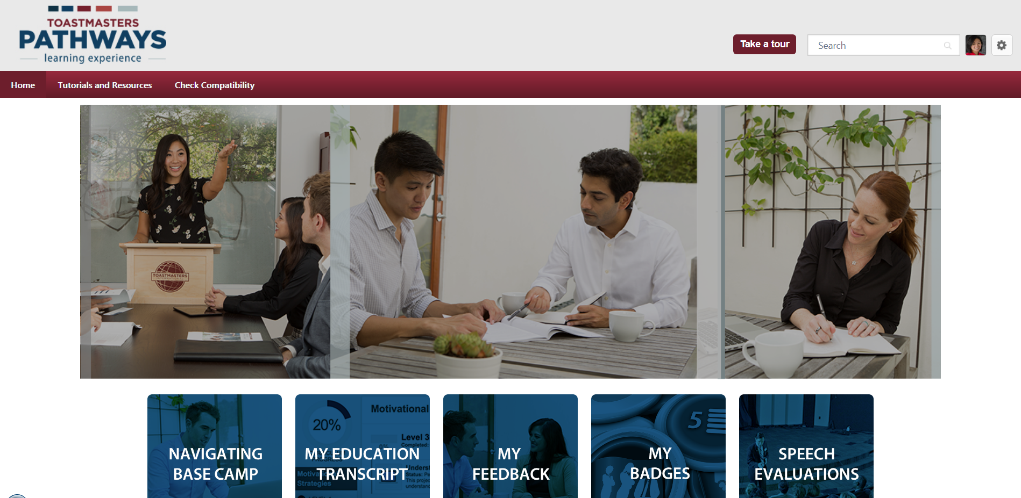
Click on the “gear” near your profile’s picture > go to “My Account”

Slide 6
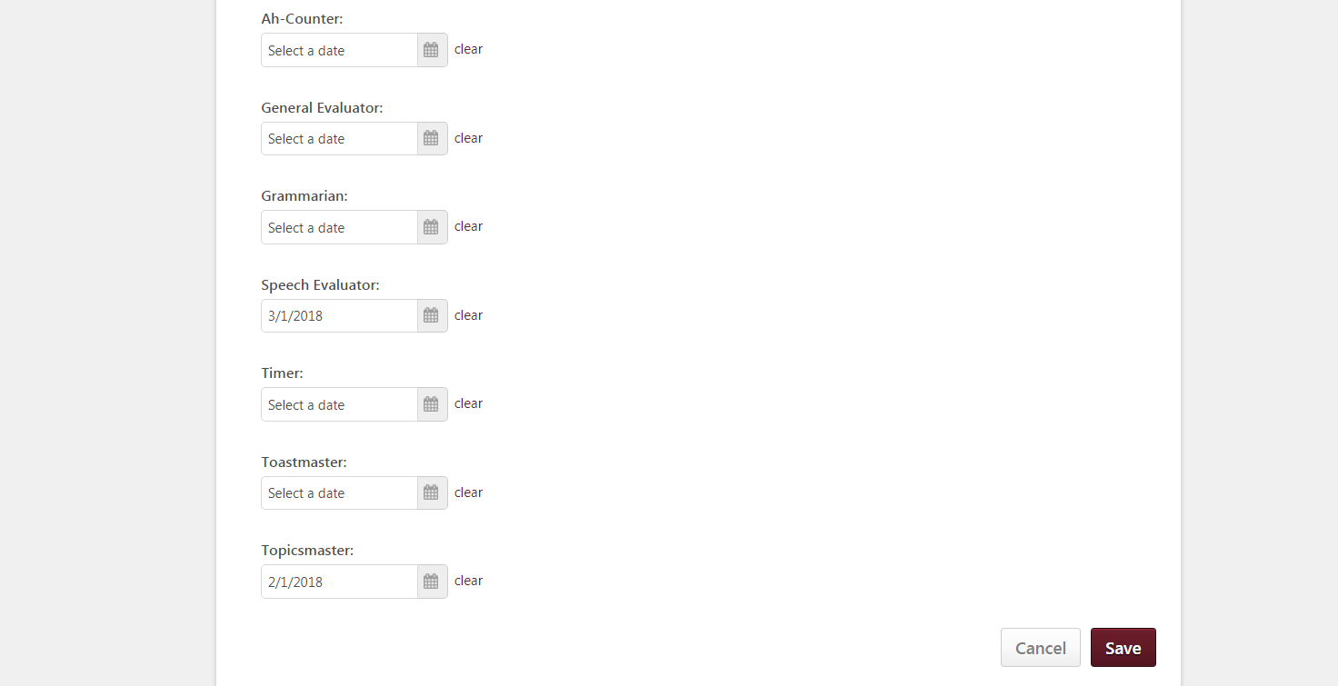
Scroll down page to Meeting Roles and enter the date on which each role was fulfilled
Toastmasters counts Ah-Counter and Grammarian as two separate roles, but you can put the same date for both since we combine the roles during meetings
If you’ve forgotten the exact date, you can look at past agendas on our club’s site
Don’t forget to press SAVE

Slide 7
Questions?
Email your officers at toastmasters@list.nist.gov

