Slide 1


Instructions
Taking credit for Ice Breaker completed in old CC system

Slide 2
The Ice Breaker
No matter which Path you select, the Ice Breaker is the first speech you give
Those in the old Competent Communicator (CC) system will have already completed an Ice Breaker
  You can choose to transfer it to Pathways or do another Ice Breaker
The instructions to follow show you how to take credit for the Ice Breaker

Slide 3
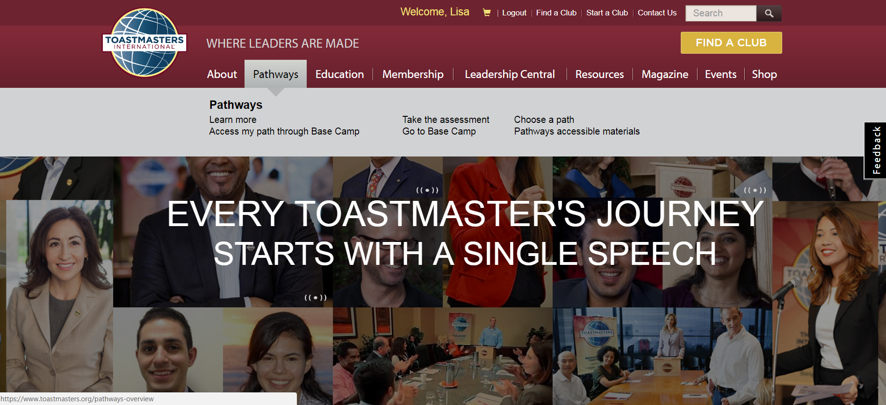
Navigate to Basecamp

Slide 4
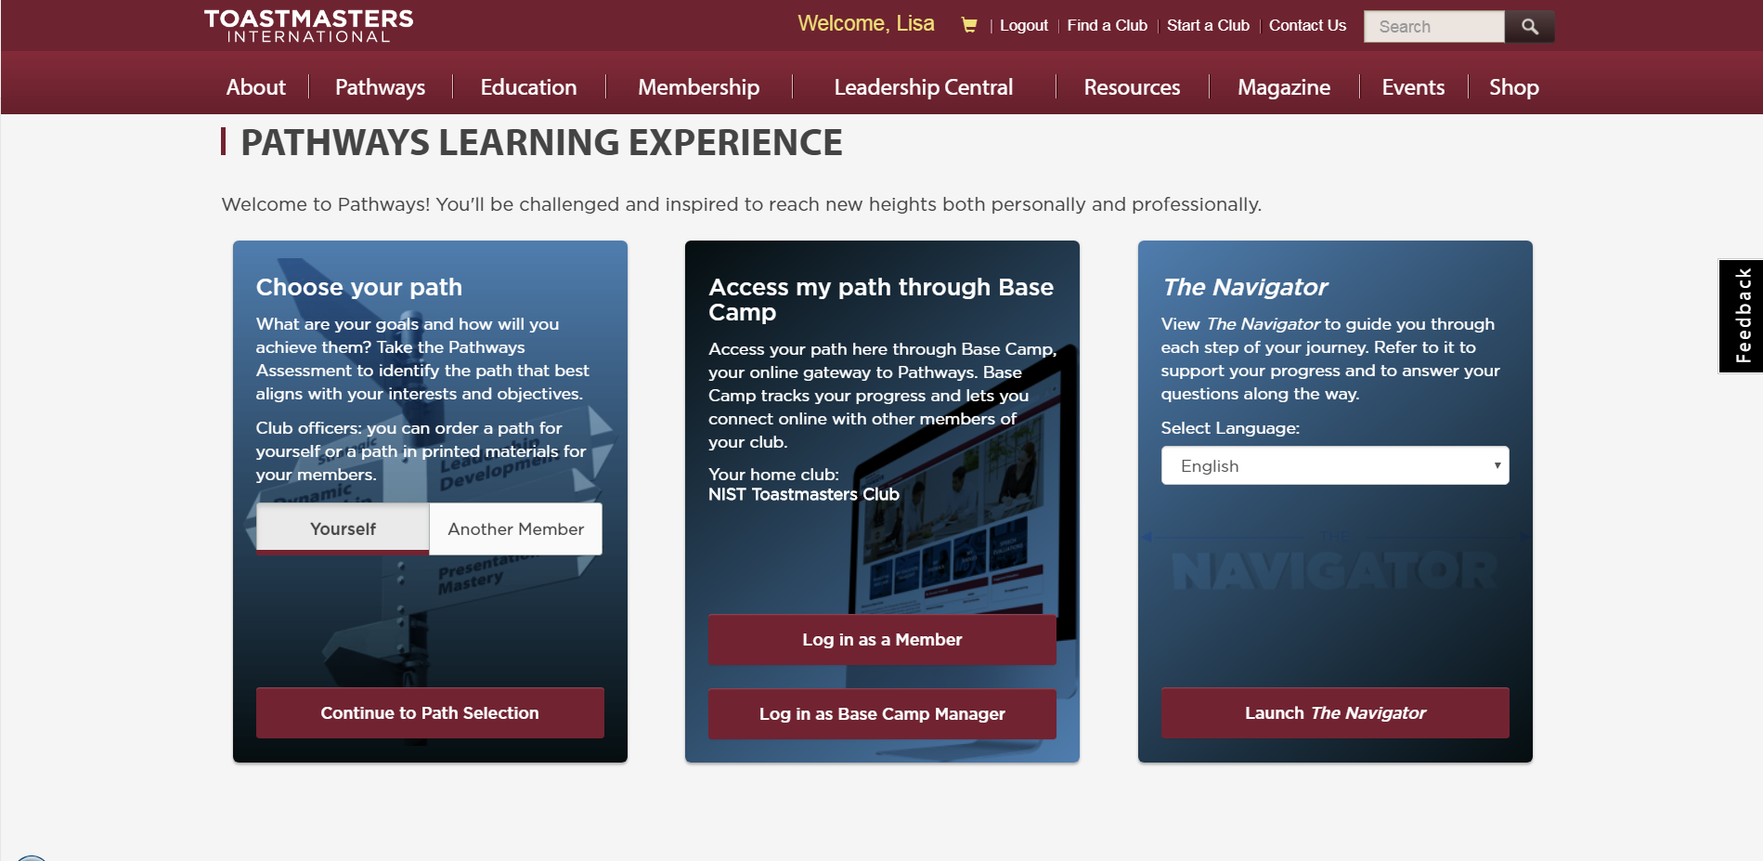
Log in as a Member

Slide 5
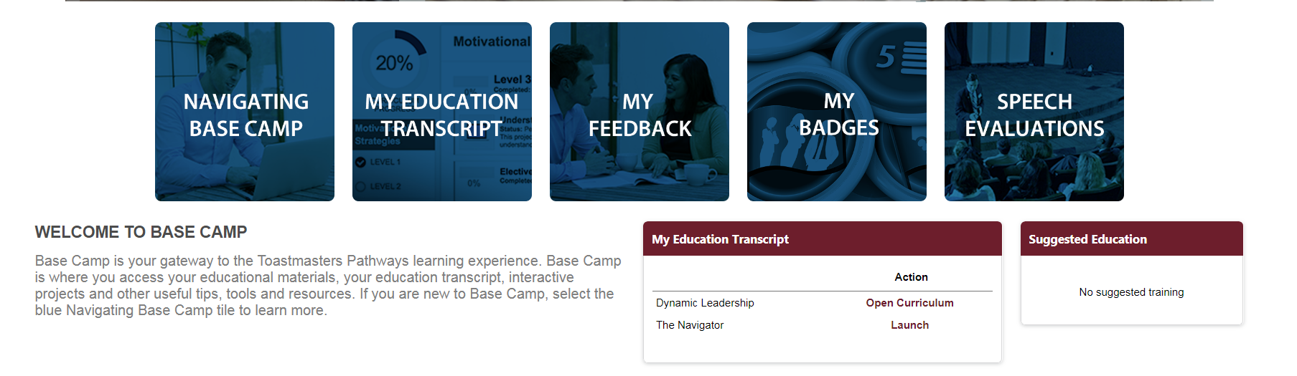
Click on Open Curriculum

Slide 6
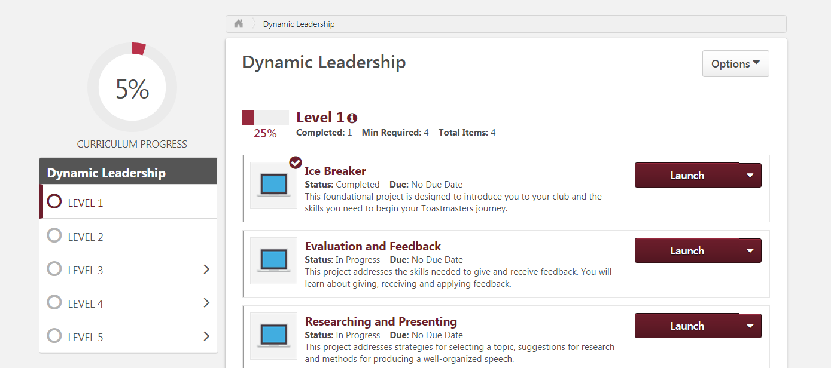
Make sure you’re at Level 1
Launch the Ice Breaker module
Make sure you allow pop-ups on the browser
Go through the slides and complete the Before Speech and After Speech Evaluation as best you can

Slide 7
That’s it!
You are not required to upload an evaluation
That’s it!

Slide 8
Questions?
Email your officers at toastmasters@list.nist.gov

