Slide 1


Instructions
Uploading Evaluations of your speeches

Slide 2
Speaker Evaluations
Your evaluator can complete the evaluation either by using
  The fillable PDF
    Download here by finding the correct project name
    Or the speaker can email you the form
  By filling-in the printed form
You then upload the complete form (either PDF or scanned PDF/image)

Slide 3

Navigate to Basecamp

Slide 4
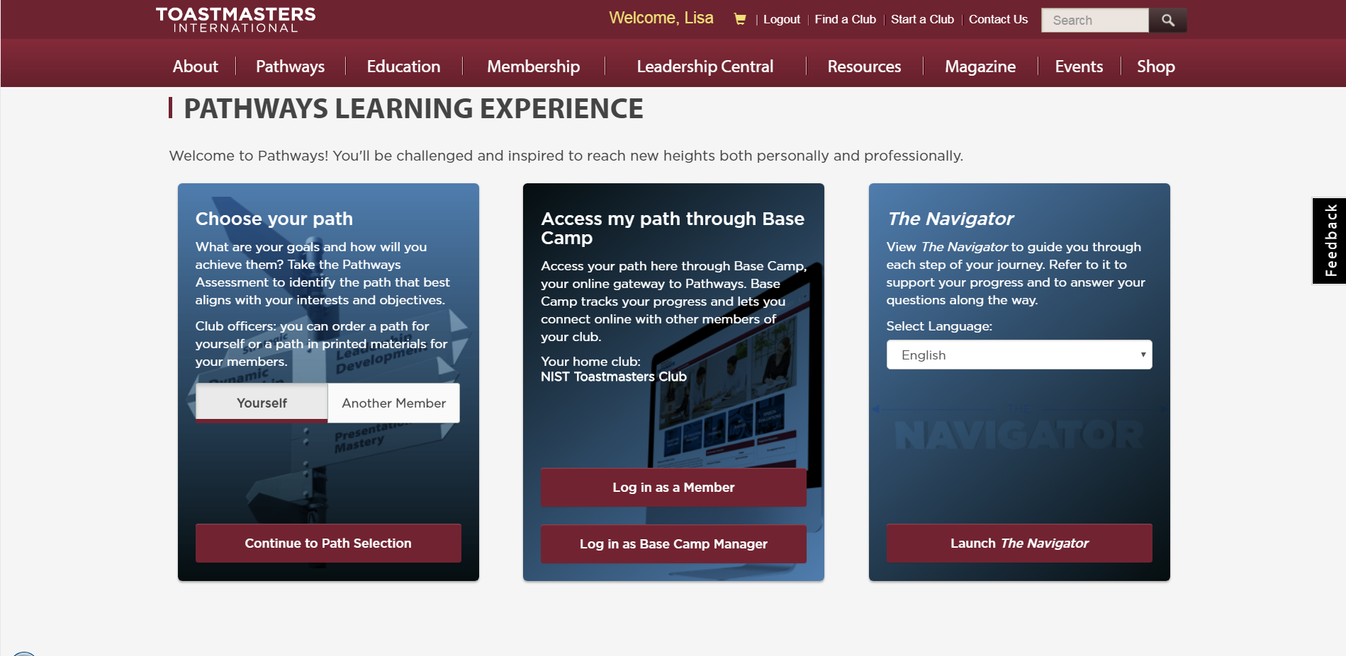
Log in as a Member

Slide 5
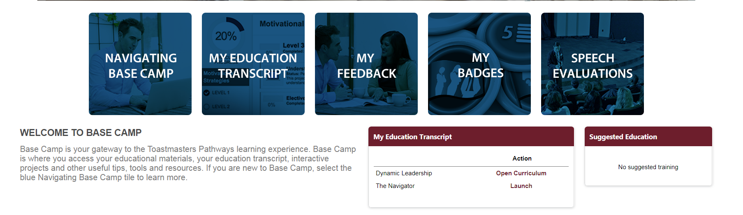
Click on My Education Transcript

Slide 6
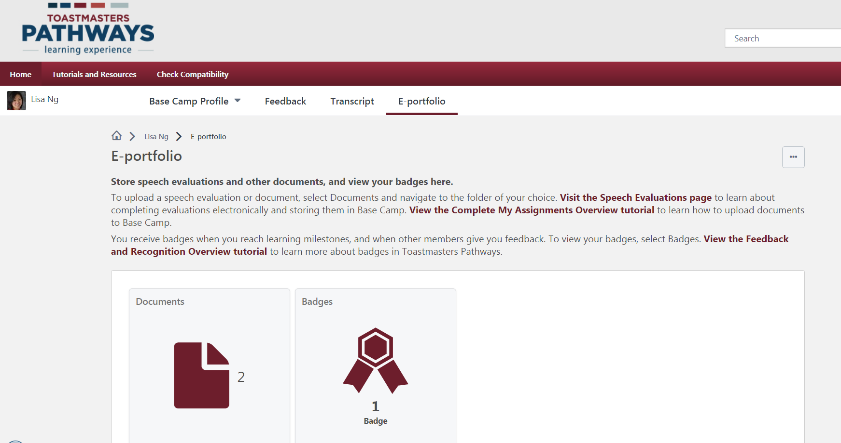
Click on E-portfolio
Click on Documents

Slide 7
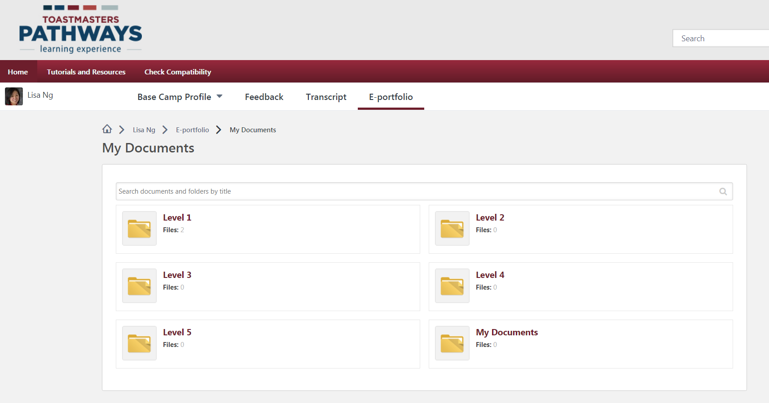
Click on correct Level folder

Slide 8
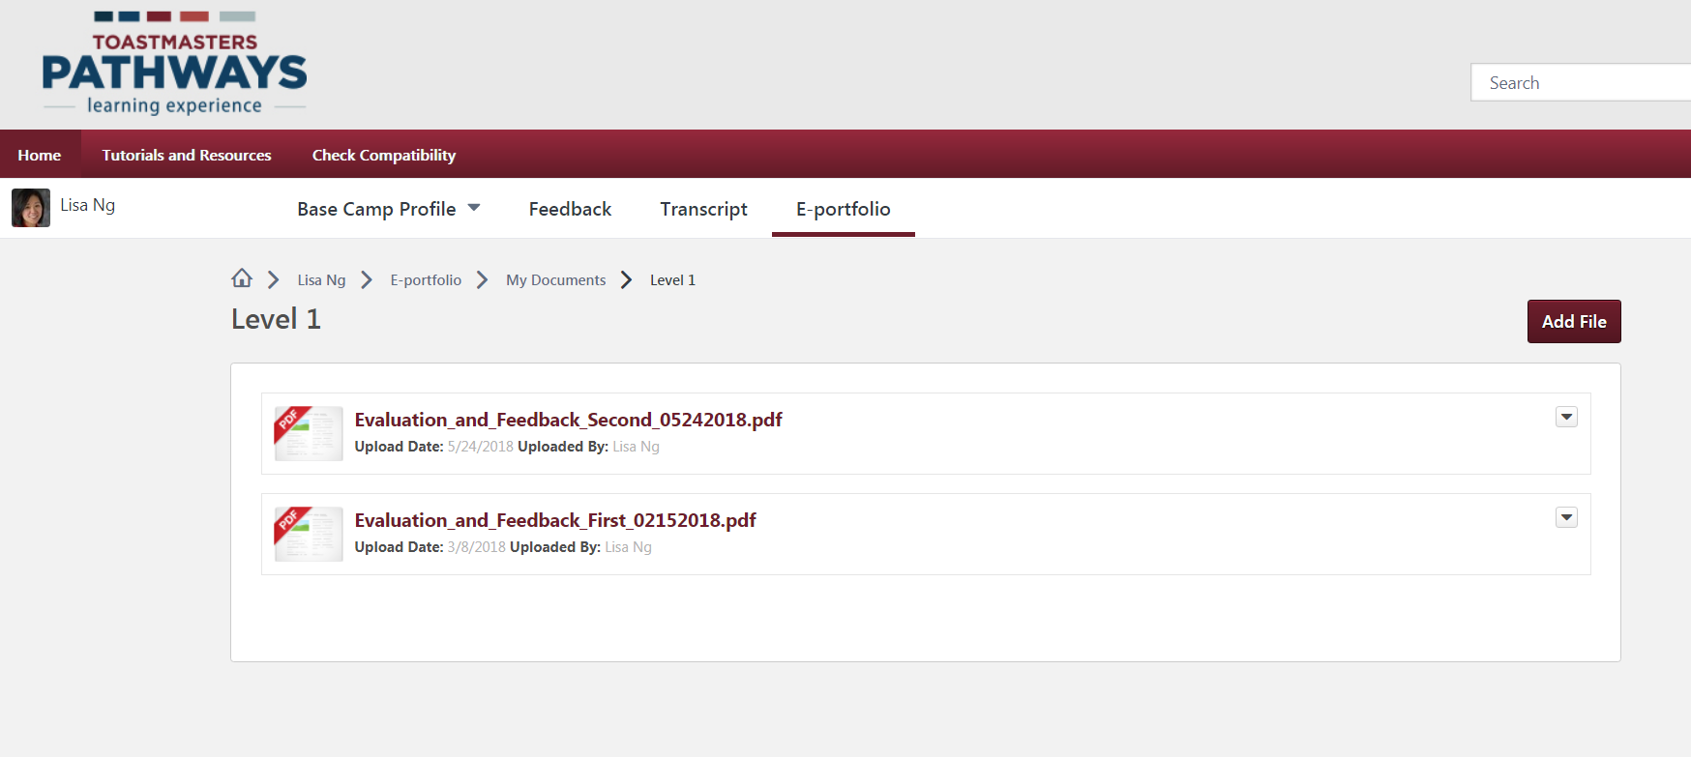
Click on correct Level folder
Use the Add file button to upload your files
You can use any naming convention you want
Here, they’ve been named according to the Project Name (Evaluation and Feedback), what project number it is (1st, 2nd, etc), and what date they were completed

Slide 9
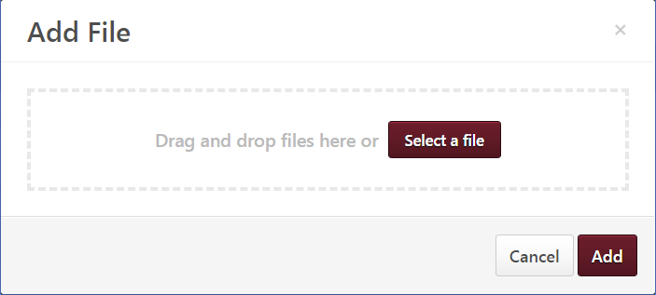
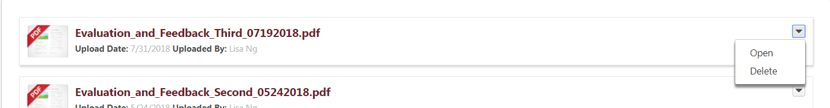
Click Select a File in pop-up window
Then click Add
You can Open and Delete files using the drop-down icon

Slide 10
Be sure to complete the self-evaluation by going back to Home and clicking on Open Curriculum

Slide 11
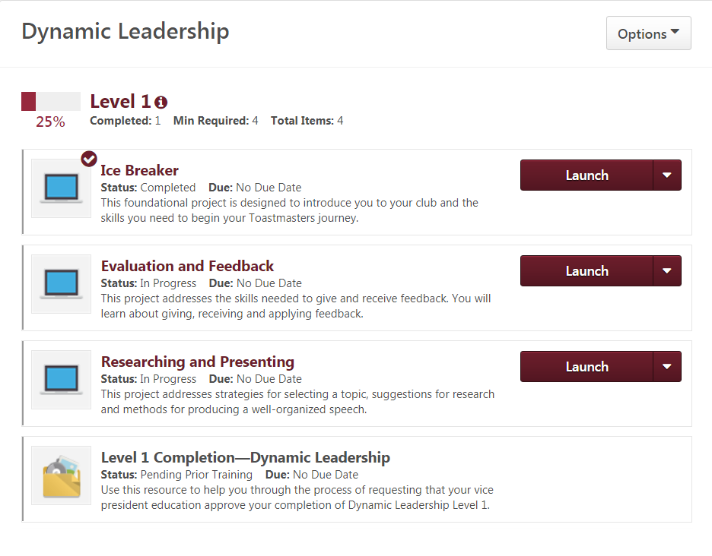
Checkmarks appear next to completed Projects
Launch incomplete Projects

Slide 12
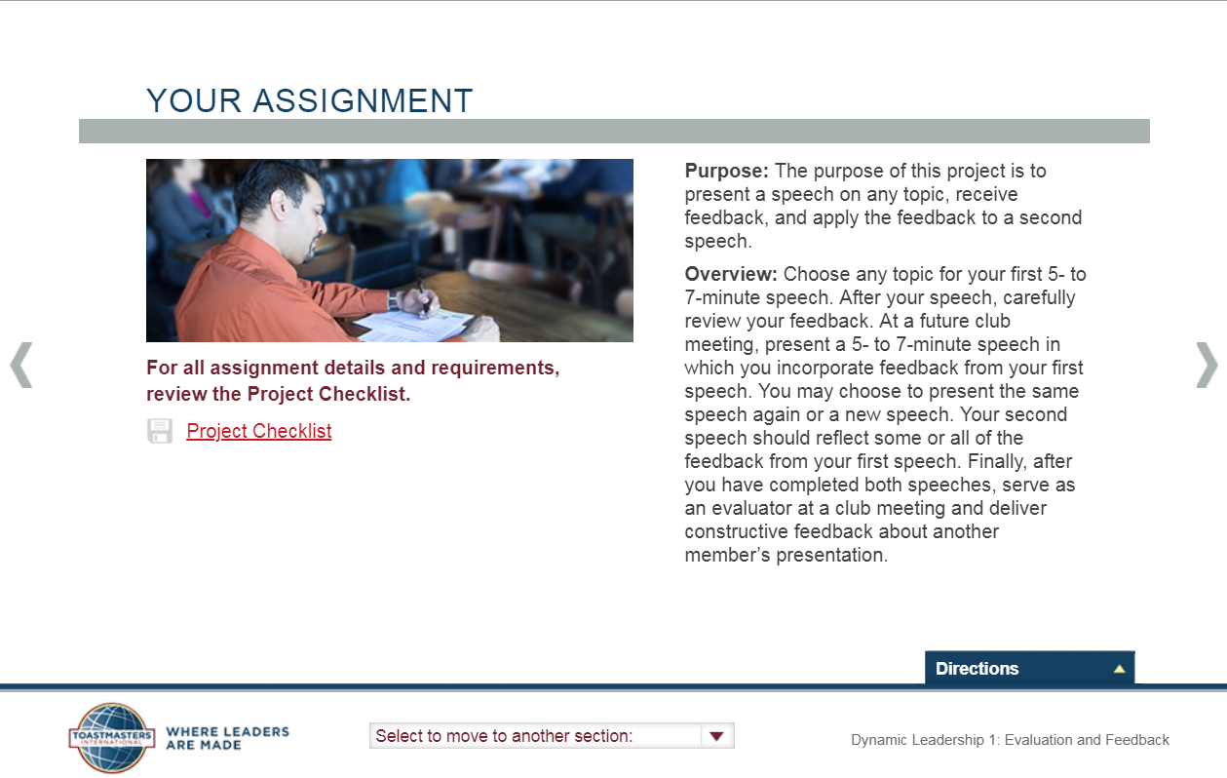
Click on pop-up menu below to preview slides/assignments in this Project

Slide 13
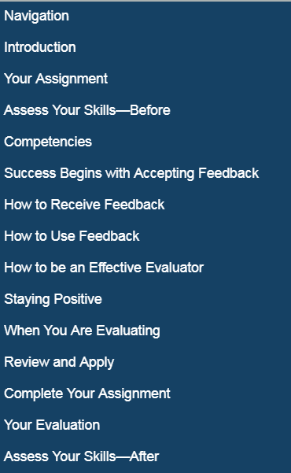
Take note of “Your Assignment” and the Assessments
These are the slides/tasks within the Evaluation and Feedback Project of Level 1
  Your Assignment lists the tasks within the Project
  Take the Before and After assessments to complete the Project

Slide 14
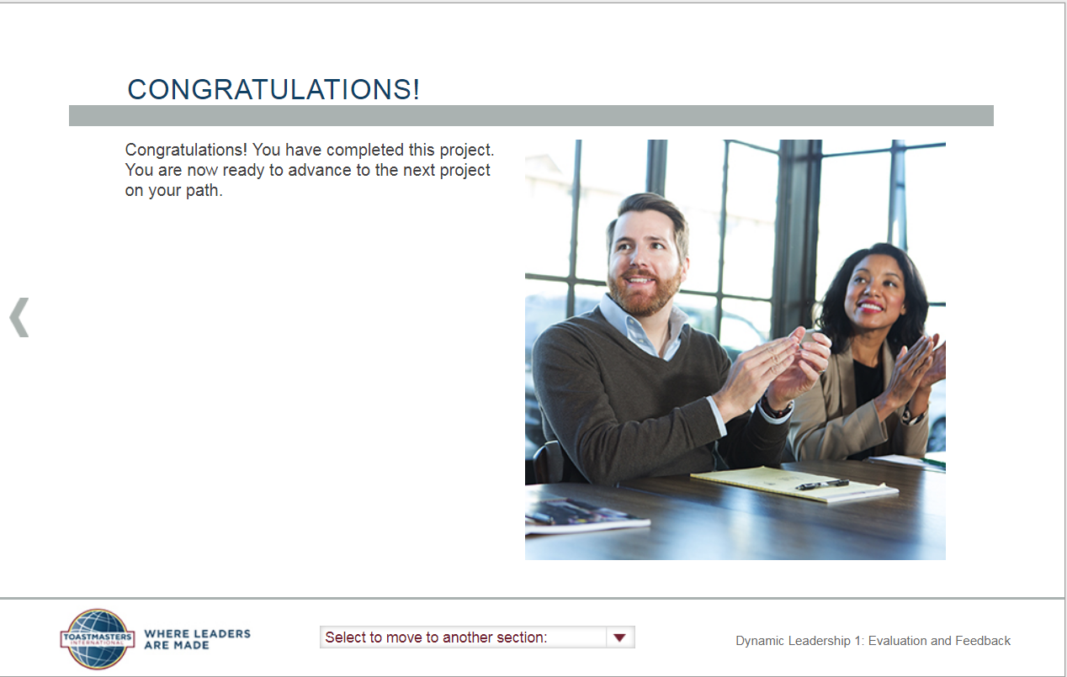
You receive a Congratulations notice when you complete a Project within a Level

Slide 15
Questions?
Email your officers at toastmasters@list.nist.gov

